Slide 1
AIRCRAFT RISK ANALYSIS

Slide 2
INTRODUCTION

Slide 3
Beginning
Overview: The project aims to provide insights to Aviation Limited Company on the best aircraft to purchase when entering the aviation business based on historical aviation data analysed
Business understanding: Aviation Company Limited needs data-driven insights to select safe, reliable aircraft models for commercial and private use. Understanding which aircraft have lower accident rates will minimize operational risk and maximize return on investment.

Slide 4
DATA EXPLORATION

Slide 5
Fields used for analysis
Sn | Fields Name | Type | Missing values % | Handling missing values by
1 | Aircraft Make | Categorical | 1.68 | Replace with Mode
2 | Aircraft Model | Categorical | 1.72 | Replace with Mode
3 | Risk Score | Numerical | 0 | Replace with Mean
4 | Aircraft damage status | Categorical | 5.15 | Replace with Mean
5 | Total minor injury | Numerical | 15.46 | Replace with Mean
6 | Event date | Categorical | 14.82 | Drop
7 | Country | Categorical | 1.81 | Replace with mode

Slide 6
DATA VISUALIZATION AND INSIGHTS OBTAINED

Slide 7
Tableau Data visualization
Click on the link to access the interactive dashboard >>
https://public.tableau.com/authoring/Elizabeth_Project_1

Slide 8
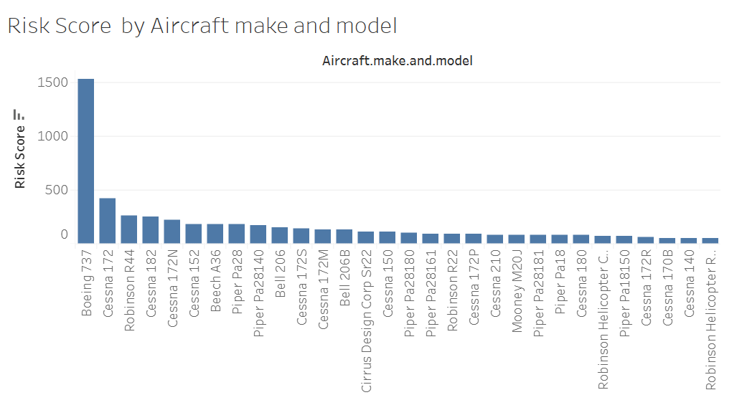
Top 20 low-risk, frequently used aircraft
Observation:
Top 20 aircraft with the most accidents but a low risk score
Conclusion:
This indicates a strong performance despite the high accidents rate

Slide 9
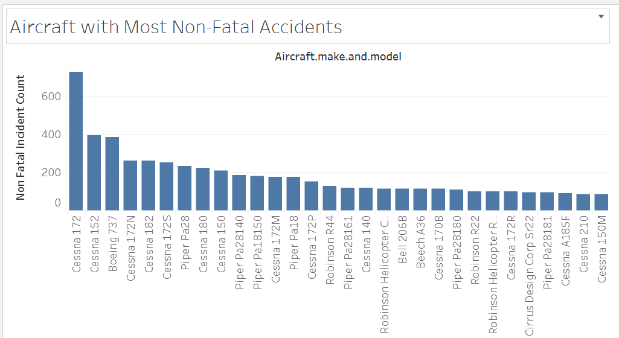
Aircrafts with most non-Fatal Accidents
Observation:
Top 20 aircraft with the most non fatal accidents
Conclusion:
The graph suggests better survivability or minor incidents by the make and model of the aircraft

Slide 10
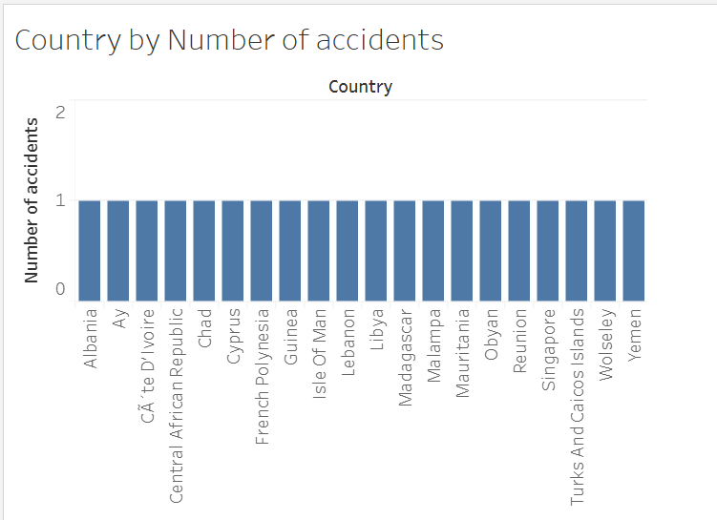
Countries with the lowest accident count
Observation:
Top 12 countries with the lowest number of aircraft accidents.
Conclusion:
These countries have a low likelihood of aircraft accidents occurring

Slide 11
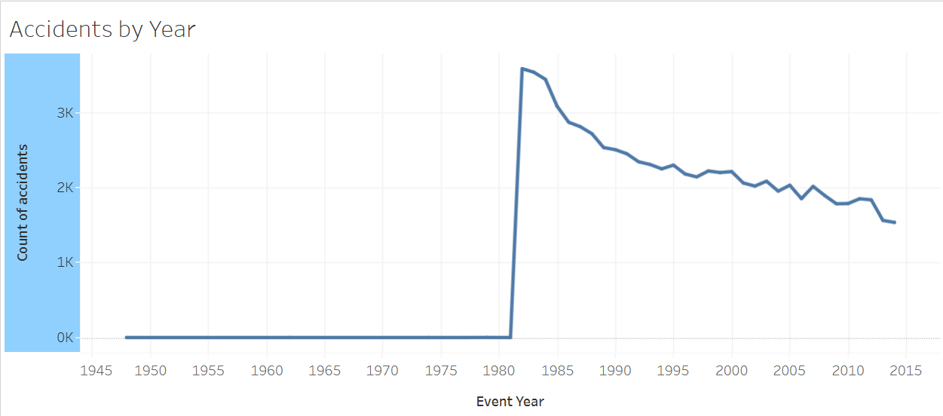
Aircraft accidents over time
Observation:
There was a sharp rise od accidents around 1881
There has been a steady decline in accidents since then
Conclusion:
Aviation safety has improved over time

Slide 12
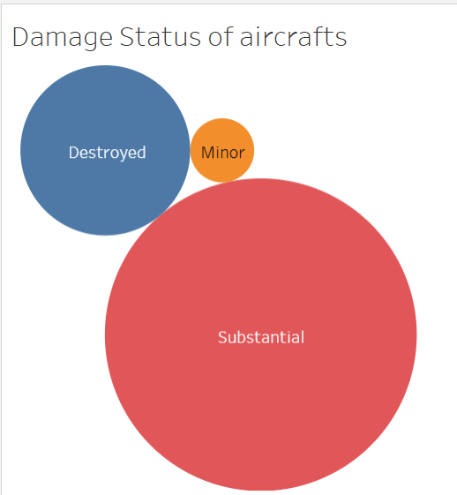
Damage STATE OF AIRCRAFTS
Observation:
When accidents occur, most aircraft sustain substantial damage, followed by total destruction, with minor damage being the least common.
Conclusion:
Most aircraft accidents result in substantial damage rather than total destruction or minor harm, indicating that while there are accidents, they are often not catastrophic

Slide 13
RECOMMENDATION

Slide 14
Based on Analysis performed the following has been noted:
The safety in the aviation field has been improving over the years
Recommended Low-Risk Aircraft for the Company
Cessna Series – Models 172 and 182
Piper Series – Models Pa28 and Pa18
Robinson Helicopters – R44
Boeing 737
Beech A36
Aviation Company Limited should expand operations in African countries, as the majority show a low risk of aircraft accidents based on historical data
In cases where an accident might occur, there is a high probability the aircraft will be deemed substancial

Slide 15
Q&A Session?

Slide 16
THANK YOU
Prepared by: Elizabeth Gichure
LinkedIn Profile: https://www.linkedin.com/in/elizabeth-gichure

